Slide 1
STUDY OF THE SECOND VIRIAL COEFFICIENTS: NEW CHALLENGE FOR QSPR
Elena Mokshyna, Victor E. Kuz’min, Vadim I. Nedostup

Slide 2
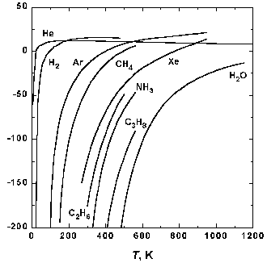
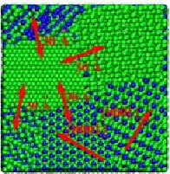
WHY CHALLENGE?
The compressibility factor is expressed as a series expansion in either density (reciprocal molar volume) or pressure:
Main purposes:
Development of approach to QSPR of T-dependent properties
Calibration of the descriptors
Prediction for new complex organic compounds

Slide 3
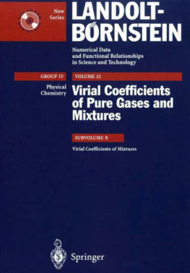
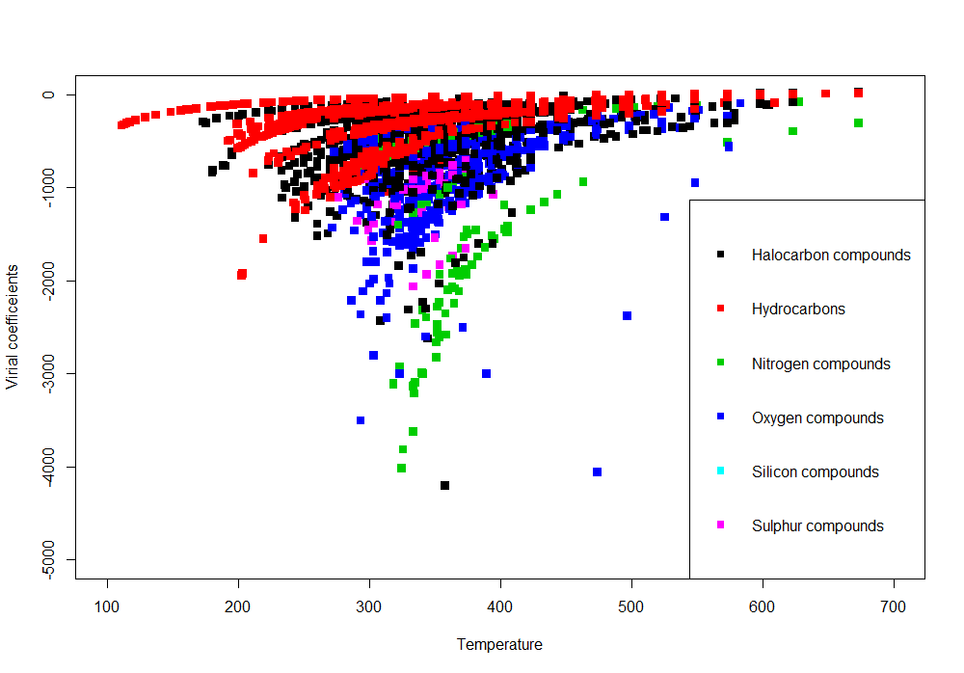
EXPERIMENTAL DATA
Number of compounds: 262
Number of points: 4787
Range of virial coefficients: -5891 – 391 cm³/mol
Range of temperatures: 110 – 773 K

Slide 4
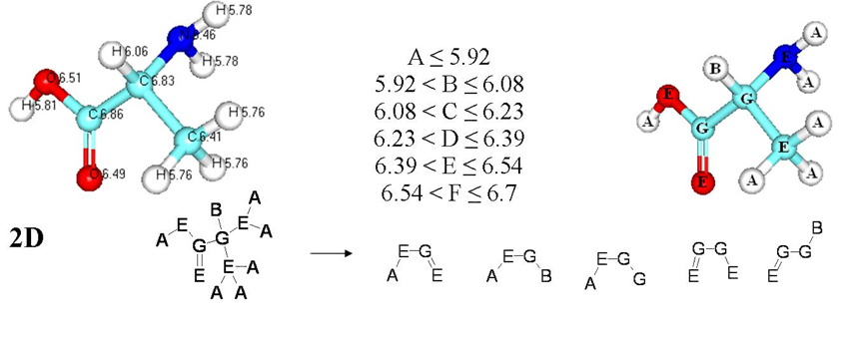
DESCRIPTORS & MODELLING TECHNIQUES
SiRMS descriptors:
Temperature as a single descriptor:
B = f(T)
Two-layer QSPR model:
a = f(descriptors)
b = f(descriptors)
B = f(a, b)

Slide 5
STATISTICAL ANALYSIS
Various statistical methods:
MLR (Multi-Linear Regression)
PLS (Projection on Latent Structures)
RF (Random Forest)
SVM (Support Vector Machines) with radial basis function kernel
Rigorous 3x5-fold stratified external cross-validation
Training set
Test set
! Data on virial coefficient of compound
under all the temperatures
are put in the test set

Slide 6
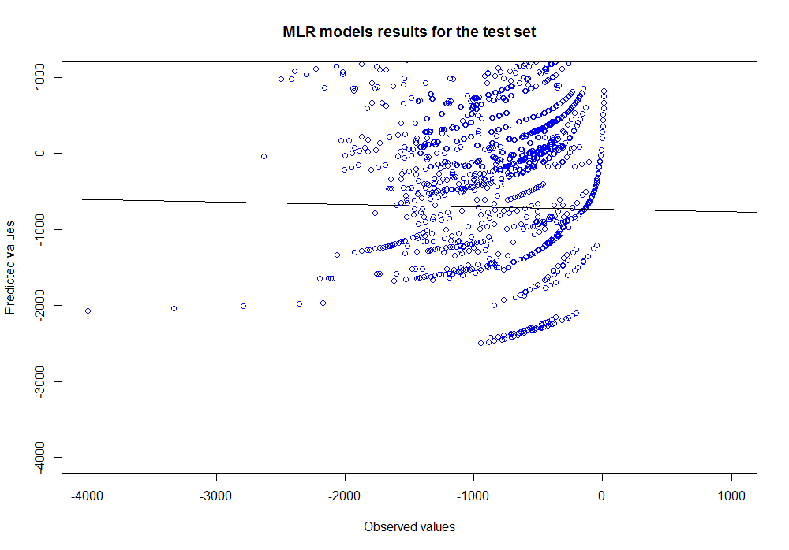
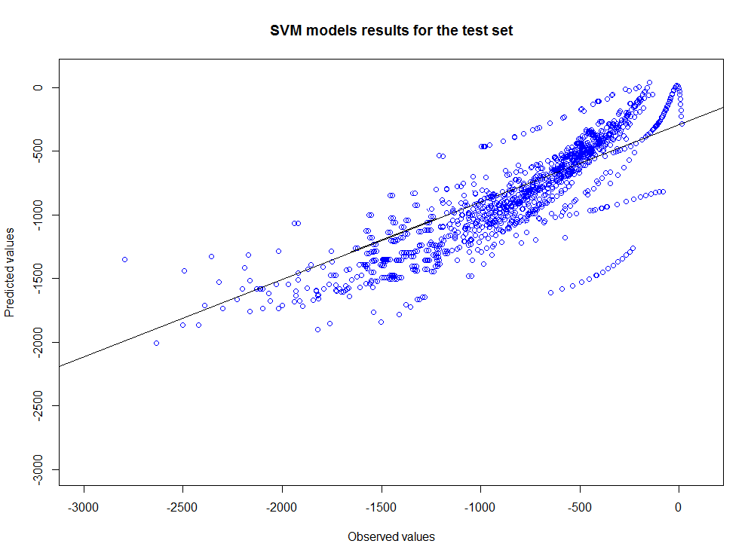
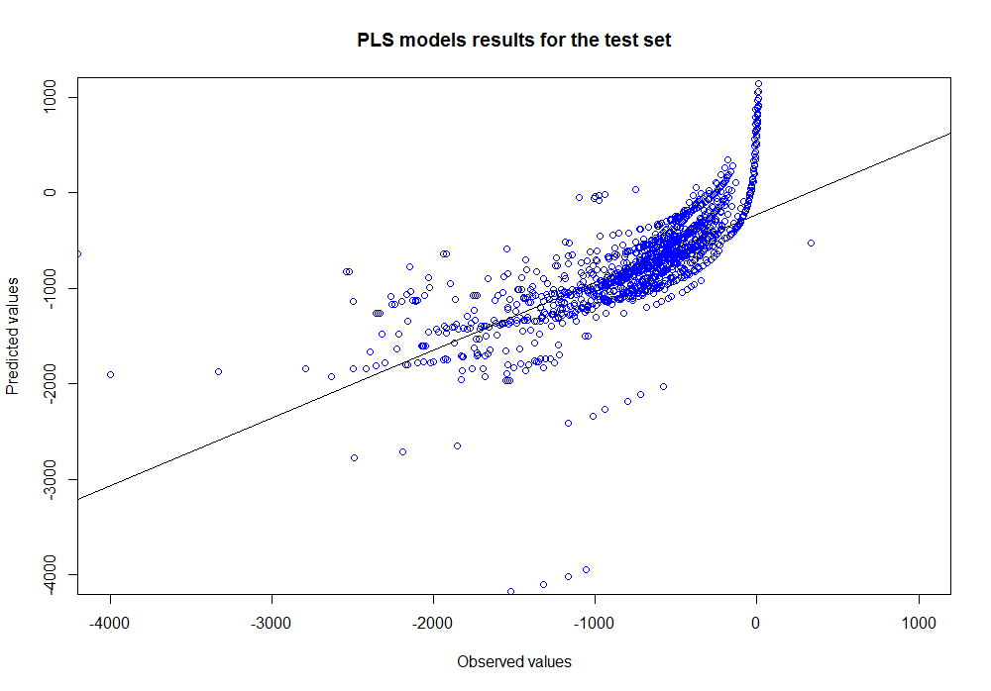
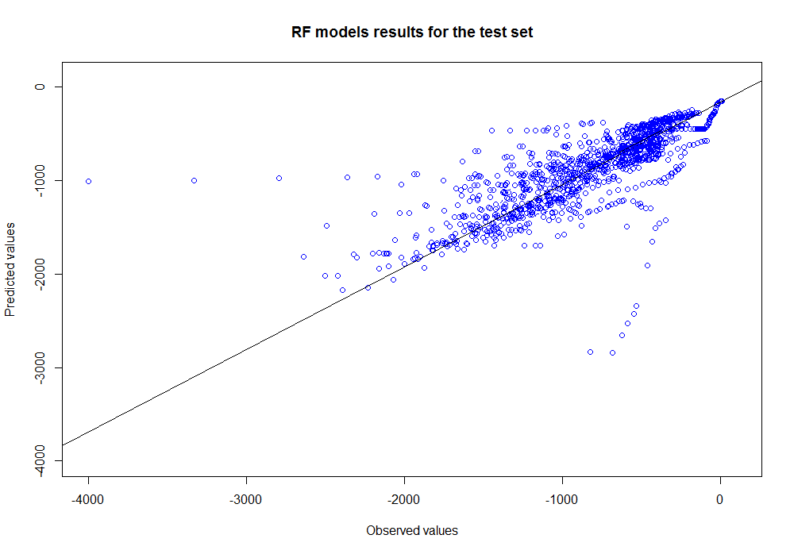
RESULTS for B = f(T)
R²_{ws} = 0.53
R²_{ts} = 0.19
R²_{ws} = 0.87
R²_{ts} = 0.68
R²_{ws} = 0.94
R²_{ts} = 0.71
R²_{ws} = 0.71
R²_{ts} = 0.45

Slide 7
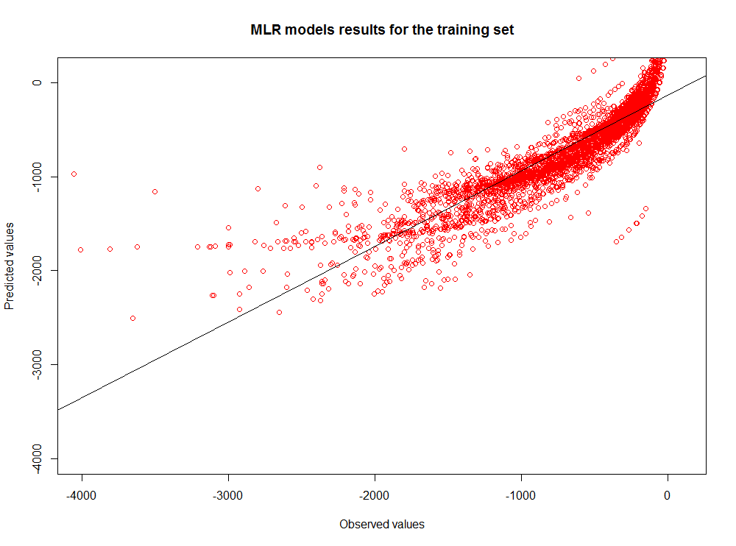
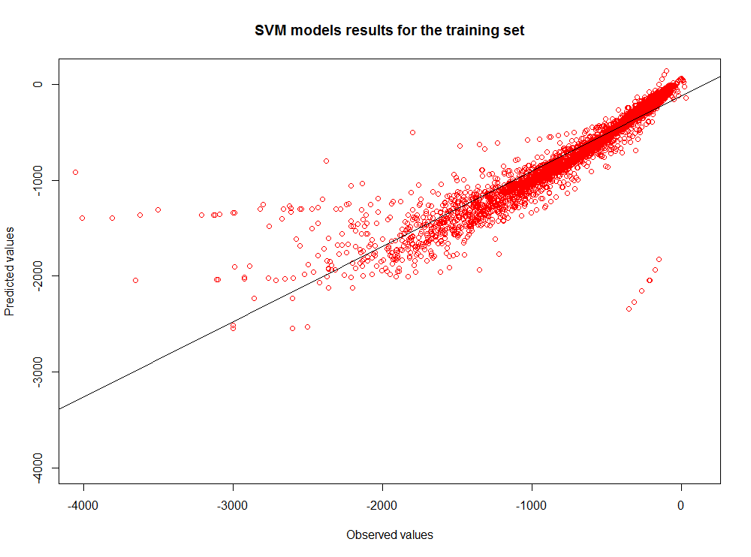
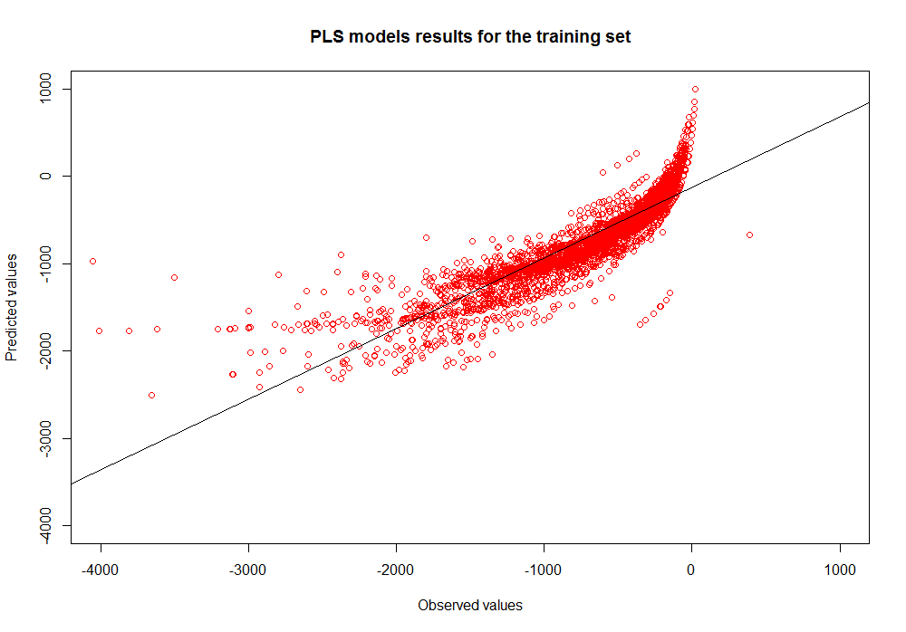
RESULTS for B = f (a,b) a = f(descriptors), b = f(descriptors)
R²_{ws} = 0.95
R²_{ts} = 0.75
R²_{ws} = 0.88
R²_{ts} = 0.51
R²_{ws} = 0.98
R²_{ts} = 0.85
R²_{ws} = 0.90
R²_{ts} = 0.72

Slide 8
EXPERIMENTAL ERRORS VS. ERRORS OF MODELS

Slide 9
Relative Variable Influence

Slide 10
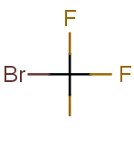
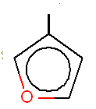
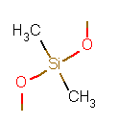
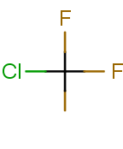
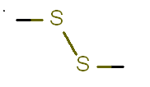
Influential fragments
Some examples from the generated fragments library :
*
*
*
*
*

Slide 11
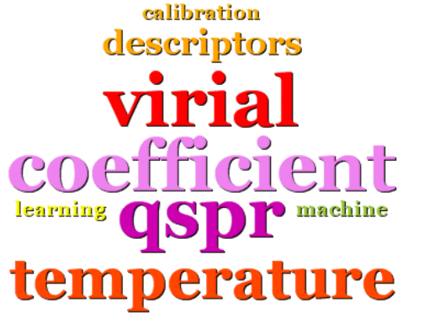
So….
MISSION IS POSSIBLE,
BUT CHALLENGE IS NOT COMPLETED!

Slide 12
Thank you for the attention!

